Slide 1

NEW
Return Trade and Smart News
Android Internship in doodleblue
14-12-2018
MINJUNG SHIM

Slide 2

COMPANY PROFILE
doodleblue is a digital strategy consulting boutique that loves to learn, collaborate and create all things digital.
It is equipped to cater to a mix of global brands, leading consultancies, startups, fortune 500s and governments.
With digital transformation being the need of the hour, it helps clients make significant and lasting improvements in the digital space.
DOODLEBLUE
INTRODUCTION
TECHNOLOGY
SCREEN DESIGN
CONCLUSION

Slide 3


RETURN TRADE AND SMART NEWS
DOODLEBLUE
INTRODUCTION
TECHNOLOGY
SCREEN DESIGN
Return Trade app has 2 games:
Banking: to release companies' stocks into a game format.
Smashing Pot: broken game, where companies randomly hidden in a pot are found within a given opportunity.
Smart News is designed to make it easy to subscribe to news from Google online or offline.
Available in five languages.
Users can subscribe to any of the 3 category of articles.
CONCLUSION

Slide 4



REQUIRED TOOLS AND TECHNOLOGY
NEW
Android Studio
Bottom sheet layout
Custom Tool bar
Frame animation
DOODLEBLUE
Navigation drawer layout
Retrofit
JSON news API
Dagger 2
MVP
Firebase Notification Center (FNC)
WIFI
Android phone
INTRODUCTION
INTRODUCTION
TECHNOLOGY
All applications are used in the SQLite database using the Room persistence library
The language was also implemented using KOLTIN
SCREEN DESIGN
CONCLUSION
DATABASE
LIBRARY
LANGAUGE

Slide 5
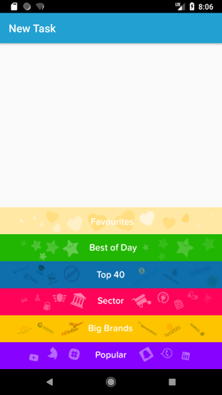
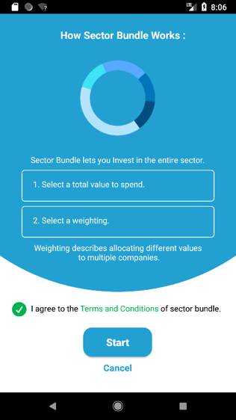
BANKING
< Screen ID : Main & Agreement >
DOODLEBLUE
NO | Description
01 | If the users select one of the menus, they must go to the Agreement Page.
02 | The users should press Start in the Agreement page to start the game. (Users must check the agreement button before press the start button)
INTRODUCTION
TECHNOLOGY
SCREEN DESIGN
01
CONCLUSION
02

Slide 6
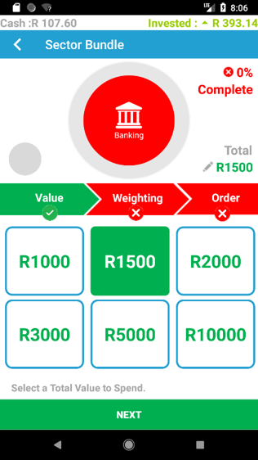
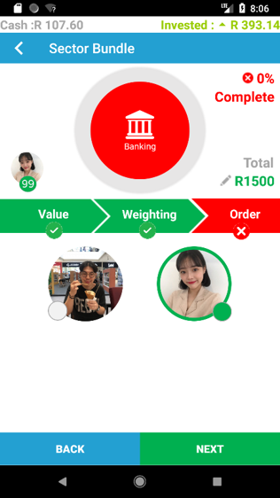
BANKING
< Screen ID : Main & Agreement >
DOODLEBLUE
01
02
NO | Description
01 | Value refers to the value of money in Rupees.
02 | Weighting refers to selecting the user’s own weighting per share.
INTRODUCTION
TECHNOLOGY
SCREEN DESIGN
CONCLUSION

Slide 7
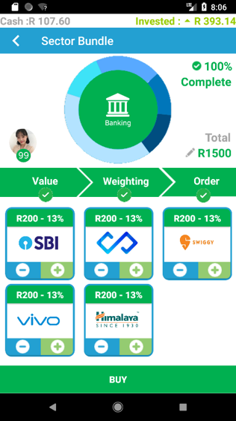
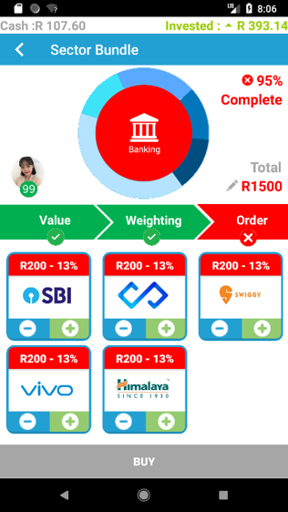
BANKING
< Screen ID : Order >
01
DOODLEBLUE
Ex. All companies are not selected
NO | Description
01 | Order refers to the company.
02 | For each company, users can select and remove a company through the plus and minus buttons.
03 | The order is not completed until all companies are selected.
03
INTRODUCTION
TECHNOLOGY
SCREEN DESIGN
02
CONCLUSION

Slide 8
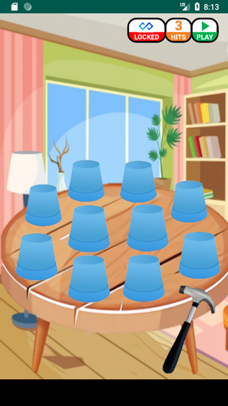
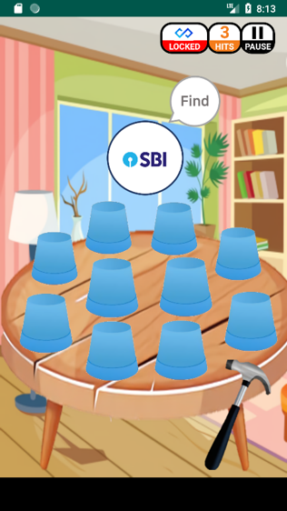
SMASHING POT
< Screen ID : Game Start >
DOODLEBLUE
NO | Description
01 | When users press the Play button, the Companies that they need to find will be on the screen.
02 | The company is randomly placed in one of the 10 pots. The users can find the company by searching it among the hidden pots within three attempts.
01
INTRODUCTION
02
TECHNOLOGY
SCREEN DESIGN
01
CONCLUSION

Slide 9
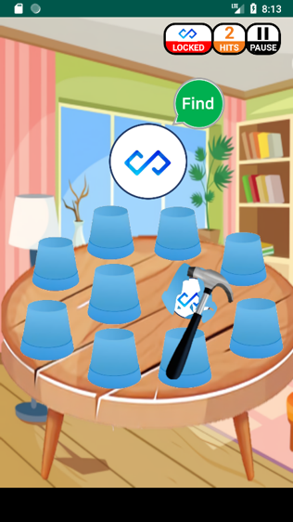
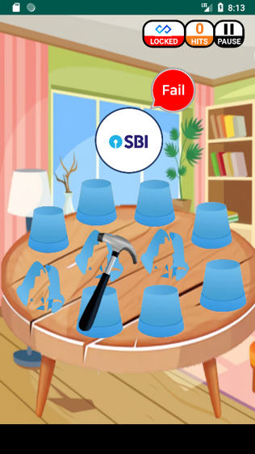
SMASHING POT
< Screen ID : Game Start >
DOODLEBLUE
01
02
NO | Description
01 | If they cannot find the company within three attempts, it results in failure.
02 | If users fail, they can start the game again by pressing the play button.
INTRODUCTION
TECHNOLOGY
SCREEN DESIGN
CONCLUSION

Slide 10
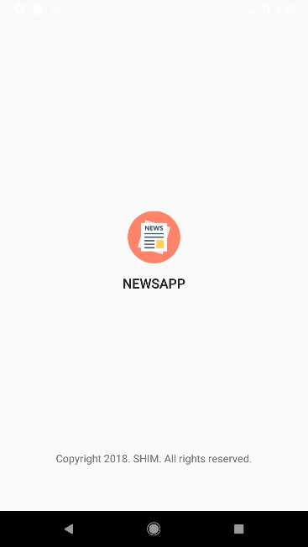
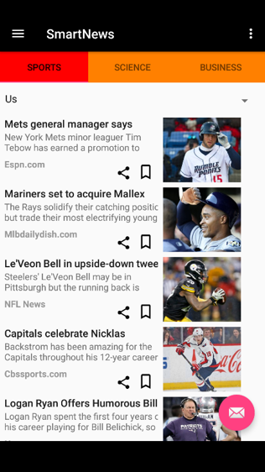
SMART NEWS
< Screen ID : Loading & Main >
01
DOODLEBLUE
03
INTRODUCTION
02
TECHNOLOGY
NO | Description
01 | Loading Page
02 03 | 5 Languages 3 Categories
SCREEN DESIGN
CONCLUSION

Slide 11
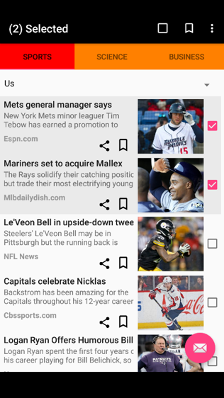
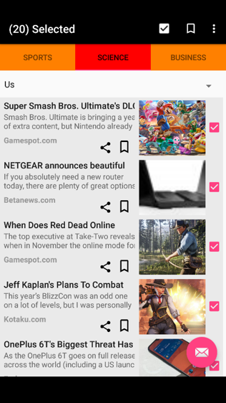
SMART NEWS
< Screen ID : Single and Multi-Select >
DOODLEBLUE
01
02
NO | Description
01 | Each time the user selects an article, he can visually check how many articles are selected.
02 | If users select an article through a long touch, they can manage the entire article efficiently by creating various icons in the top bar.
INTRODUCTION
TECHNOLOGY
SCREEN DESIGN
CONCLUSION

Slide 12
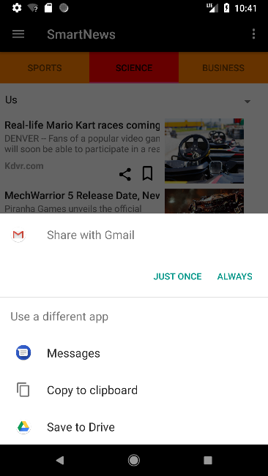
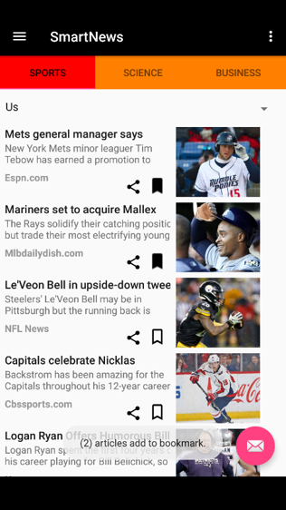
SMART NEWS
< Screen ID : Shares & Bookmarks >
DOODLEBLUE
INTRODUCTION
NO | Description
01 | Users can click the Share button to share the contents of the article through various media.
02 | Bookmark buttons allow users to add or release articles to or from a bookmark page.
TECHNOLOGY
01
SCREEN DESIGN
CONCLUSION
02

Slide 13
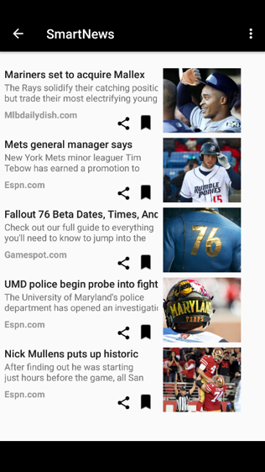
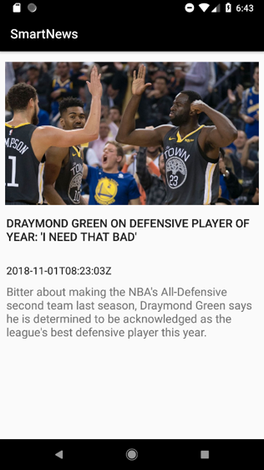
SMART NEWS
< Screen ID : Bookmark & Detail Page >
01
02
DOODLEBLUE
INTRODUCTION
NO | Description
01 | Bookmark pages allow users to view multiple articles added in bookmarks at once.
02 | The Details view page lets users subscribe in more detail to the article.
TECHNOLOGY
SCREEN DESIGN
CONCLUSION

Slide 14
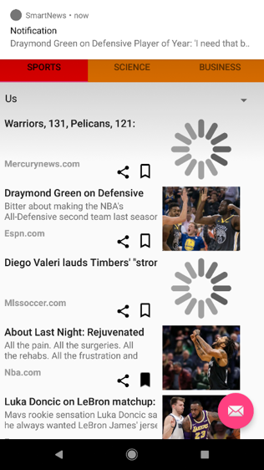
SMART NEWS
< Screen ID : Push Alarm >
DOODLEBLUE
01
NO | Description
01 | If the server sends a push alarm by selecting a major article, the same alarm is sent to the device for all users using this application, which allows users to go directly to the Details page when the alarm is selected.
INTRODUCTION
TECHNOLOGY
SCREEN DESIGN
CONCLUSION

Slide 15
CONCLUSTION
DOODLEBLUE
The Return Trade and Smart News has been successfully implemented in Kotlin using Android Studio and SQLite.
More features can be included in this application.
The system uses Android Studio and SQLite.
INTRODUCTION
TECHNOLOGY
SCREEN DESIGN
CONCLUSION

Slide 16
Thank you.
14-12-2018
MINJUG SHIM

